Slide 1
FY19 NA-LA TECHNOLOGY ARCHITECTURE Workshop
Artificial Neural Networks
Version 1.0
Last update 2018-10-03
Notes:
Focus​
Describe the Faculty Guide, its organization, and contents.​
​
Note to Learning Coach​
Have faculty open up their Faculty Guides and review how they are organized into main sections for faculty prep and the days of the school.​
They are further sub-divided by tabs to separate modules.​
Point out the Daily Faculty Planner at the front of the guide, and emphasize to faculty that this planner is THE time management tool for the school. ​
Detailed durations, stop and end times, and reminders are documented in this spreadsheet. ​
Faculty can also use this spreadsheet to keep track of which faculty is assigned to be the Primary Instructor for each agenda item.​

Slide 2
agenda
Introduction of machine learning
software installation
Neural networks - background
NN – inner workings
working session
visualization
Questions & Follow-up

Slide 3
code and presentation
https://github.com/ameet123/na_la_nn

Slide 4
Installation steps
Install anaconda
Downgrade python 3.5 [optional]
Create and activate conda environment [optional]
Install packages in python
Keras
Pandas
Scikit-learn

Slide 5
Installation
Anaconda-3
https://www.anaconda.com/download/ install 64-bit windows
python 3.7 version
downgrade python – tensorflow only works with 3.5
conda install python=3.5
open navigator and start command prompt with python
confirm – python –V => 3.5.6
Alternate: anaconda 4.2.0 from archives:
https://repo.continuum.io/archive/Anaconda2-4.2.0-Windows-x86_64.exe
pip install tensorflow
conda install keras => This installs tensorflow as well.
confirmation : open python prompt
python
import keras

Slide 6
environment & package installation
conda create –n neural
conda activate neural
conda install seaborn – installs matplotlib
conda install pandas
conda install scikit-learn – test/train dataset split

Slide 7
machine learning
machine learning
approach
un-supervised
supervised
reinforcement
classification
regression
tasks
decision tree
neural network
algorithm

Slide 8
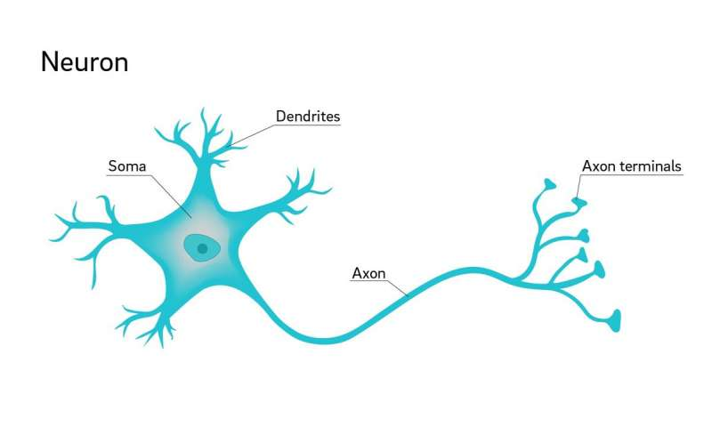
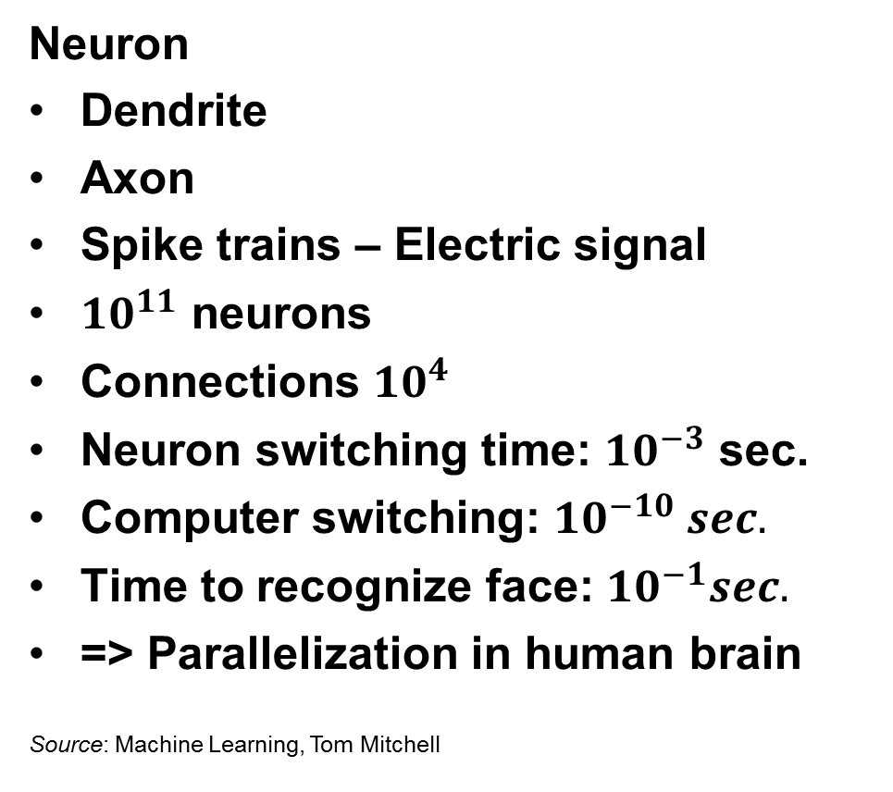
Background
Neuron
Dendrite
Axon
Spike trains – Electric signal
${10}^{11}$ neurons
Connections ${10}^{4}$
Neuron switching time: ${10}^{−3}$ sec.
Computer switching: ${10}^{−10} sec.$
Time to recognize face: ${10}^{−1}sec.$
=> Parallelization in human brain
Source: Machine Learning, Tom Mitchell
Credit: David Baillot/ UC San Diego source:
https://medicalxpress.com/news/2018-07-neuron-axons-spindly-theyre-optimizing.html

Slide 9



Objective behind “prediction”
Secret key
Complex Process or phenomenon
Output or result

Slide 10




Real-life process
Ate cookie ? {Y, N}
$$2^{2}$$
SLAP? {Y, N}
Before lunch? {Y, N}

Slide 11

Artificial Neuron
Perceptron
Input layer
Weights
Threshold, theta
Predicted value
x₁
w₁
y
x₂
w₂

Slide 12
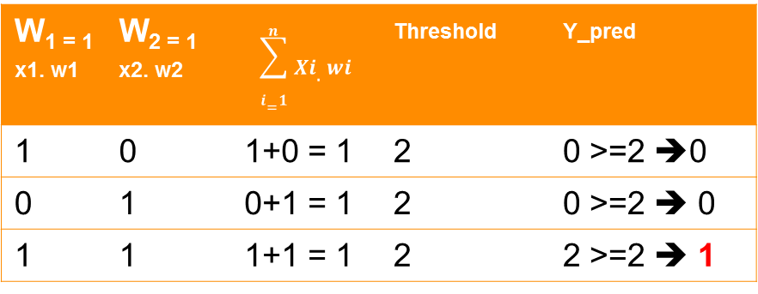
Boolean Function: AND
X₁ | X₂ | _{y}
1 | 0 | 0
0 | 1 | 0
1 | 1 | 1
Find the value of the threshold and weights
W₁ = ? | W₂ = ? | _{Threshold= ?}
W_{1 = 1 x1. w1} | W_{2 = 1 x2. w2} | $$\sum_{i=1}^{n}{Xi.wi}$$ | _{Threshold} | _{Y_pred}
1 | 0 | 1+0 = 1 | 2 | 0 >=2 ➔0
0 | 1 | 0+1 = 1 | 2 | 0 >=2 ➔ 0
1 | 1 | 1+1 = 1 | 2 | 2 >=2 ➔ 1
Source: based on Udacity course, GA-Tech cs 7641 https://www.udacity.com/course/machine-learning--ud262

Slide 13
Forward and backward
activation
error

Slide 14
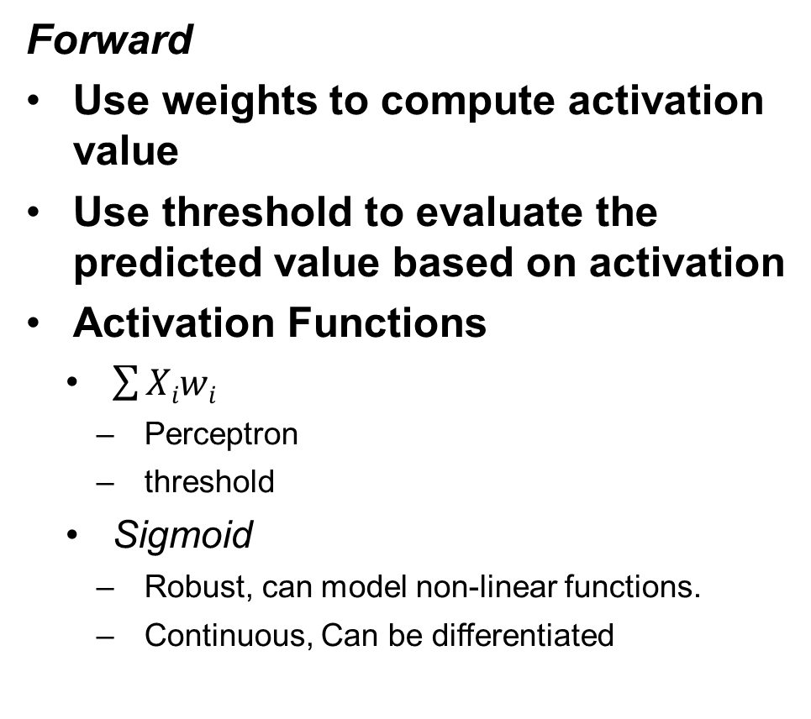
propagation
Forward
Use weights to compute activation value
Use threshold to evaluate the predicted value based on activation
Activation Functions
$\sum{Xiwi}$
Perceptron
threshold
Sigmoid
Robust, can model non-linear functions.
Continuous, Can be differentiated
Back
Cost function
Error propagated backwards from output
Weights updated
Objective = {weights such that error minimized}
Type of problem: ?
Optimization
Source: https://www.coursera.org/learn/neural-networks-deep-learning

Slide 15
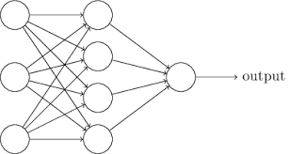
Neural network
Input
Hidden layers
Units in hidden layers
output

Slide 16
Features of ANN
Longer training times
Fast evaluation or prediction
Discrete or real-valued output
Explanatory capability is not important.

Slide 17
Example NN in Python

Slide 18

dataset
EEG and eye state detection
source: https://archive.ics.uci.edu/ml/datasets/EEG+Eye+State
14 fields and 1 label
binary classification
https://www.emotiv.com/

Slide 19
prepare data
use numpy to read data
split into train and test
convert labels to integer: 0 or 1
data = np.loadtxt(file, delimiter=',', skiprows=1)
x_train, x_test, y_train, y_test = train_test_split(X, Y, test_size=0.2, random_state=7)
y_train = y_train.astype(int)

Slide 20
build model & evaluate
Sequential model
add layers as needed
define activation function – for each layer
Define cost function – loss for the model
define optimizer: how should we “minimize the error”
gradient descent,
first order derivative.
Evaluate
model = Sequential() model.add(Dense(in_neurons, input_dim=input_dim, activation='relu')) model.add(Dense(out_neurons, activation=‘sigmoid’)) model.compile(optimizer='adam', loss='binary_crossentropy', metrics=['accuracy'])
score = model.evaluate(X_test, Y_test, verbose=0)

Slide 21
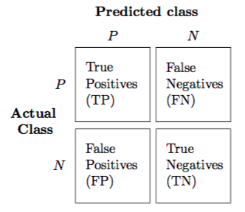
confusion matrix:
source:
https://rasbt.github.io/mlxtend/user_guide/evaluate/confusion_matrix/

Slide 22
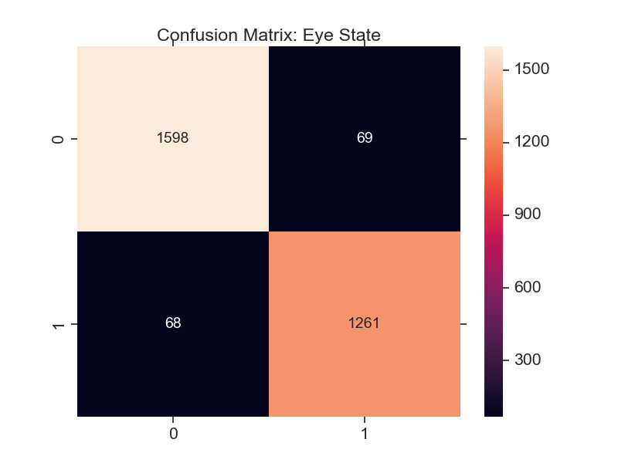


scaling
Normalize the data

Slide 23
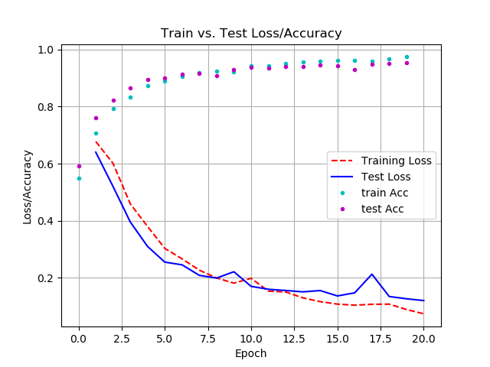
test/train errors
number of iterations to run
overfitting

Slide 24
QUESTIONS & ANSWERS

Slide 25
backup slides

Slide 26
Backpropagation algorithm
Set up multi-layered neural network.
Use sigmoid or other differentiable activation function.
Compute feed forward output values going from the input to the output.
For each (x_{i}, y_{i}) pair in training sample:
Compute feed forward output values going from input to output
Propagate the error back through the network from output to input
Calculate error term for the output unit , this is delta
For each hidden unit, calculate its error term, this is delta
Update each weight w_{ji} w_{ji} + delta_w_{ji}
delta_w_{ji} = eta . delta_j * x_{ji}
Delta term makes use of the partial derivative of the sigmoid function. This is analogous to (y – y_pred)

Slide 27
backup
mklink /D %HOMEDRIVE%%HOMEPATH%\anaconda C:\Users\ameet.chaubal\Documents\software\anaconda3
Matplotlib support failed
downgrade matplotlib
to check version
import matplotlib
matplotlib.__version__
conda install matplotlib=2.1.2

